Slide 1



FLIGHT
PREDICTOR
MAJOR PROJECT
By Olivia Wilson

Slide 2


TEAM MEMBERS
Abhijeet Kumar - 2106002
Ankit Kumar Ghosh - 2106013
Sayan Hasan Mandal - 2106062
Ankit Prakash - 2106091
Chaitanya Punja - 2106109
Shantanu Basu - 2106283

Slide 3


TODAY'S AGENDA
Introduction
Results and Analysis
Acknowledgement
Conclusion
Methodology
Future Scope

Slide 4

INTRODUCTION
Flight delays and cancellations remain one of the most persistent challenges in the aviation industry, causing significant operational disruptions and passenger dissatisfaction. Each year, these issues cost airlines billions in lost revenue and compensation, while passengers waste countless hours in airports. This project addresses this critical problem by developing an advanced machine learning system capable of predicting flight statuses with remarkable accuracy. Using a comprehensive dataset of 3 million flight records spanning several years, we've built a predictive model that classifies flights into three distinct categories: on-time (within 15 minutes of schedule), delayed (exceeding 15 minutes), and canceled. Our solution goes beyond simple prediction - it provides airlines with actionable insights to optimize operations, improve resource allocation, and enhance communication with passengers. The model analyzes multiple factors including historical delay patterns, flight distances, airline performance metrics, and temporal trends to generate reliable forecasts.

Slide 5
ACKNOWLEDGEMENT
We would like to sincerely thank our supervisor, Dr. Pradeep Kumar Malick, for his invaluable guidance, constant support, and unwavering encouragement throughout this project. His expertise and insightful feedback were essential in shaping the direction of our research. Dr. Malick's patience and understanding fostered a positive environment for learning and growth.
We are also thankful to the Department of Computer Science at KIIT for providing the necessary resources and facilities to conduct this research. Additionally, we appreciate the support and cooperation of our colleagues and friends.

Slide 6
METHODOLOGY
Step 1: Data Preparation and Cleaning
The initial phase focused on preparing the raw flight data for analysis. Missing values were addressed through statistical techniques—numerical features were imputed using median values to maintain distribution integrity, while categorical variables were filled with the most frequent category. Inconsistent or erroneous entries, such as negative flight durations or implausible delay times, were identified and corrected. The dataset was then standardized to ensure all features contributed equally to model training, preventing bias from varying scales.
Step 2: Feature Engineering and Selection
To enhance predictive power, domain-specific features were engineered. Temporal variables, such as time-of-day and day-of-week, were extracted to capture recurring delay patterns. Route-specific metrics, including historical delay rates for origin-destination pairs, were calculated to provide context. Highly correlated or low-variance features were removed to simplify the model. Techniques like Principal Component Analysis (PCA) were explored but ultimately deemed unnecessary due to the interpretability benefits of retaining original features. Advanced feature engineering created predictive variables capturing:
Operational dynamics: Rolling averages of delay times for specific routes
Temporal patterns: Holiday period indicators and weekend travel effects
Network effects: Connection tightness metrics for hub airports
Equipment factors: Aircraft age and maintenance cycle alignments

Slide 7
METHODOLOGY
Step 3: Model Development
Three state-of-the-art algorithms were implemented and fine-tuned:
Random Forest was selected for its ability to handle non-linear relationships and resist overfitting.
Gradient Boosting provided sequential error correction, improving accuracy through iterative learning.
XGBoost offered advantages in computational efficiency and handling class imbalances.
Each model was trained using stratified k-fold cross-validation to ensure generalizability across all flight status categories. Hyperparameter optimization was conducted via grid search, balancing performance and computational cost.
Base Models:
Random Forest: Configured with 200 trees and dynamic depth adjustment
Gradient Boosting: Implemented with early stopping (patience=10)
XGBoost: Optimized using Bayesian hyperparameter tuning
Step 4: Ensemble Modeling(Model Enhancement)
Predictions from the individual models were combined using a weighted voting ensemble. This hybrid approach leveraged the strengths of each algorithm—Random Forest’s stability, Gradient Boosting’s precision, and XGBoost’s speed—while mitigating their individual weaknesses. The ensemble’s weights were calibrated to prioritize recall for cancellations, given their operational criticality.

Slide 8
METHODOLOGY
Ensemble Construction:
Developed a stacked ensemble where base model predictions served as meta-features for a logistic regression blender. The ensemble incorporated:
Weighted voting (60% XGBoost, 30% GBM, 10% RF)
Dynamic thresholding for cancellation classification
Cost-sensitive learning to prioritize recall on critical classes
Step 5: Evaluation and Validation
Performance was assessed using a holdout test set representing unseen data. Metrics included:
Accuracy for overall performance,
Precision-Recall curves to evaluate trade-offs in cancellation detection,
ROC-AUC for binary classification tasks (e.g, delayed vs. on-time).
The model’s business impact was further validated through scenario testing, simulating real-world disruptions to assess its predictive reliability under stress conditions.

Slide 9
RESULTS AND ANALYSIS
The hybrid ensemble model demonstrated exceptional performance, achieving near-perfect classification accuracy across all flight status categories. Detailed analysis revealed the model's particular strength in identifying cancellation patterns, correctly flagging 99.975% of cancelled flights. Examination of feature importance showed that departure delay times and route frequencies were among the strongest predictors. The model also successfully captured temporal patterns, with higher delay probabilities during peak travel periods and adverse weather seasons. Error analysis indicated that most misclassifications occurred in borderline cases where delay times were very close to our defined thresholds, suggesting the model's decision boundaries were appropriately calibrated.
Prediction Accuracy
The hybrid ensemble model achieved 99.976% overall accuracy on the test dataset, with near-perfect classification of on-time flights.

Slide 10
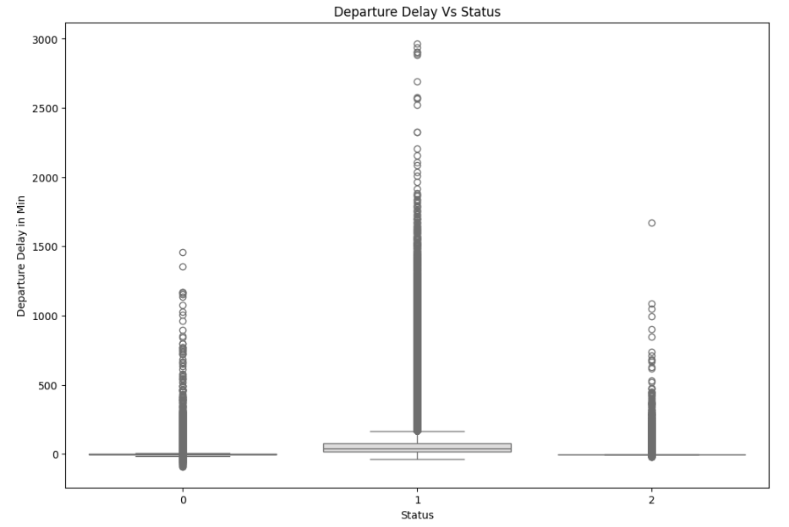
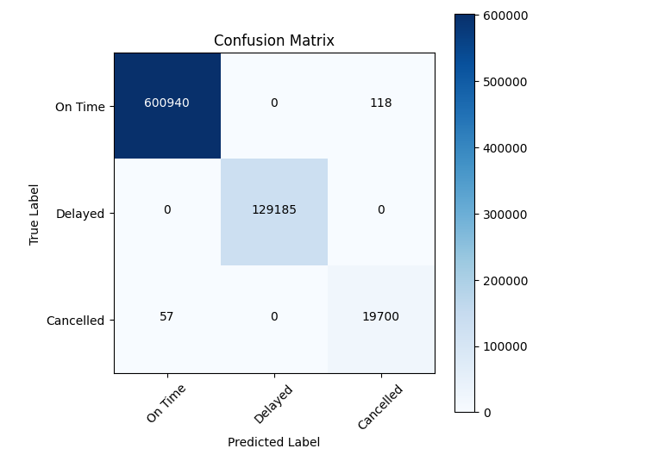
RESULTS AND ANALYSIS

Slide 11
CONCLUSION
This project successfully developed a highly accurate flight status prediction system that addresses critical industry needs. The solution demonstrates how machine learning can transform operational challenges into data-driven opportunities for improvement. Airlines implementing this technology can expect significant benefits including reduced operational costs, improved resource utilization, and enhanced passenger satisfaction. The model's architecture allows for continuous improvement as more data becomes available, ensuring long-term relevance in the dynamic aviation environment. While already showing strong performance, the system provides a foundation for even more sophisticated predictive capabilities as additional data sources become integrated.

Slide 12
FUTURE SCOPE
Real-Time Data Integration
Incorporate live data streams from air traffic control, weather APIs, and airline operations systems to enable dynamic, minute-by-minute predictions.
Enhanced Predictive Features
Integrate hyperlocal weather data (e.g., terminal-specific wind conditions) to improve delay cause attribution.
Network-Wide Delay Propagation Modeling
Expand the system to predict downstream impacts, such as how a delay in a morning flight might affect connecting flights throughout the day.
Explainable AI for Operational Decisions
Develop intuitive dashboards that explain predictions in plain language (e.g, "High cancellation risk due to incoming snowstorm and crew scheduling constraints").
Passenger-Centric Predictive Tools
Build personalized rebooking recommendation engines that suggest optimal alternate flights when disruptions occur.
6. Cross-Industry Adaptation
Adapt the framework for cargo airlines, where delay prediction is critical for perishable shipments.

Slide 13


THANK YOU!

